Slide 1
Woodland Public Schools
Facilities and Safety Report
May 2019

Slide 2
FACILITIES REPORT
School Realignment
Completed all school to school and interschool teacher and furniture move on Wednesday 6/19. We will continue to fine tune all classrooms over the next few weeks to provide the easiest transition for new and relocated staff.
Advanced Signs have the final drafts for the new school signs, and PO’s will go out this week.
Columbia Elementary portable 4-5 is near completion with new restrooms, flooring and walls, and electrical and lighting. We are currently moving in all furniture and storage cabinets and expect to have it completed from a facilities standpoint by 6/21.
Columbia Elementary portable 6-7 VCT flooring will be replaced the week of 6/24 along with a new aluminum ramp. I expect to have this portable ready for the new preschool at the end of next week.
We are waiting on a quote for new fences that should arrive next week. This change will include the portables into the secure boundary of Columbia Elementary.
Plumbers will be out the week of 6/24 to correct the elevation for restroom fixtures at North Fork Elementary.
Gas Shut-Off WMS The new seismic shutoff valve was installed as scheduled on 5/24. This valve will automatically shut off gas flow to the yellow and green hall in the event of an earthquake.

Slide 3
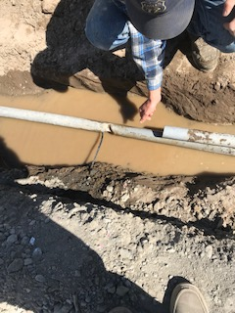
FACILITIES REPORT
Office Approach Cameras
The first of five approach cameras have been installed. The balance will be installed over the summer.
Exterior Painting
Continuation of the exterior painting program will continue at WMS next week. The exterior of the yellow/green hall and covered lunch area will be completed this summer.
Fiber Optic Line
We spent a couple of days trying to figure out why the conduit
between the district office and Columbia Elementary had collapsed.
The source of the problem turned out to be a substandard
installation of a phone line. The utility company that installed it
(still trying to figure out who) crushed the spare conduit and
intercepted our fiber optic conduit. They poorly cut a hole in it and
ran their phone wire in the fiber optic conduit to the underground
vault. This conduit runs around 600 feet and is the fiber optic lifeline to
Columbia Elementary School and KWRL.
Picture shows section
of pipe that had to be
replaced (top pipe)and
Fiber optic conduit that
was cannibalized by utility company

